Slide 1

Virtualization Migration
Technical Discovery & Risk Assessment

Slide 2
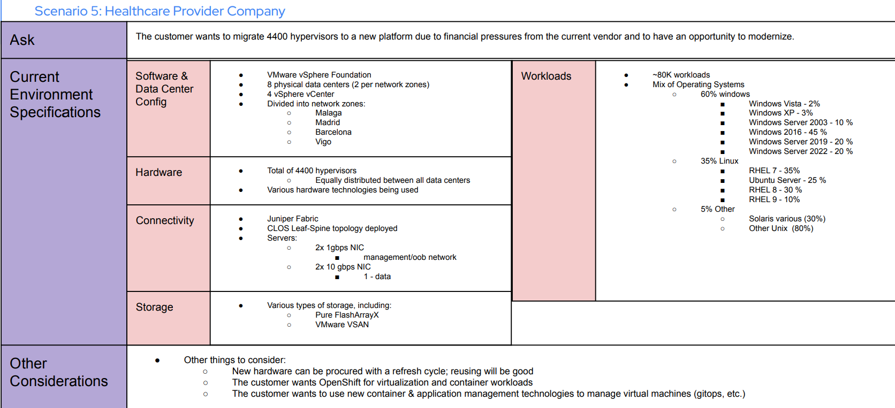
Virtualization Migration - Technical Discovery & Risk Assessment

Slide 3
Current VMware Environment
Hypervisor Distribution
vSphere Configuration
Foundation: VMware vSphere Foundation
vCenter: 4 instances (1 per data center)
Clusters: Estimated 50-80 clusters
HA/DRS: Enabled across all clusters
vMotion: Cross-cluster mobility configured
Location | Hypervisors | Estimated VMs | Utilization
Malaga | 1,100 | ~20,000 | 70-80%
Madrid | 1,100 | ~20,000 | 70-80%
Barcelona | 1,100 | ~20,000 | 70-80%
Vigo | 1,100 | ~20,000 | 70-80%
Current State
VMware vSphere (vCenter & ESXi Hosts)
vSAN / Pure FlashArray/X
→
Target State
OpenShift Kubernetes Engine
IBM Fusion Data Foundation & Pure FlashArray/X
Virtualization Migration - Technical Discovery & Risk Assessment

Slide 4
Breakup of Workloads –
Operating Systems | Easy | Medium | Hard
Windows Server 2019, 2022 | 19200
Windows Server 2016 |  | 21600
Windows Server 2003 (32-bit) (not supported) |  |  | 4800
Windows XP/Vista (not supported) |  |  | 2400
Other Linux (64-bit) (not supported) |  |  | 2800
RHEL 5 (64-bit) (not supported)
RHEL 8, 9 (64-bit) | 11200
RHEL 7 |  | 9800
Ubuntu (64-bit) (not supported) |  |  | 7000
Solaris (not supported) |  |  | 1200
Total | 30400 | 31400 | 18200
Total Workloads: 80000
Easy = 38% Medium = 39% Hard = 23 %
Virtualization Migration - Technical Discovery & Risk Assessment

Slide 5
Risk Categories & Impact Analysis
HIGH RISK
Scale Complexity
Legacy OS Support
Performance Validation
MEDIUM RISK
Network Reconfiguration
Storage Migration
Application Dependencies
LOW RISK
Modern Linux Workloads
Hardware Compatibility
Monitoring Integration
Detailed Risk Analysis
Risk Factor | Probability | Impact | Risk Level | Mitigation Strategy
Unsupported VM Support State | High | High | Critical | Rebuild & Replace where necessary
Legacy Application Compatibility | Medium | High | High | Application inventory, compatibility testing
Network Latency Increase | Medium | Medium | Medium | Network optimization, SR-IOV implementation
Storage I/O Performance | Low | High | Medium | Storage performance validation, CSI optimization
Skill Gap in Operations | High | Medium | Medium | Comprehensive training program, vendor support
Virtualization Migration - Technical Discovery & Risk Assessment

Slide 6
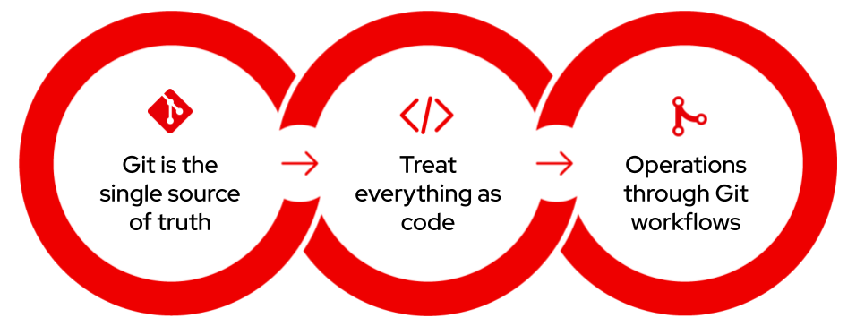
GitOps-Driven Operations
Modern VM & Container Management
Unified Management:
VMs and containers managed through same Git workflows
Infrastructure as Code for all 80K workloads
Consistent deployment across 8 datacenters
Operational Improvements:
Automated provisioning - No more manual VM creation
Version control - Track all infrastructure changes
Self-service - Teams deploy via Git commits
Faster recovery - Rebuild from Git state
Real Impact:
From manual processes → Automated GitOps workflows
From configuration drift → Consistent, declarative state
From reactive operations → Proactive, policy-driven management
Virtualization Migration - Technical Discovery & Risk Assessment

Slide 7
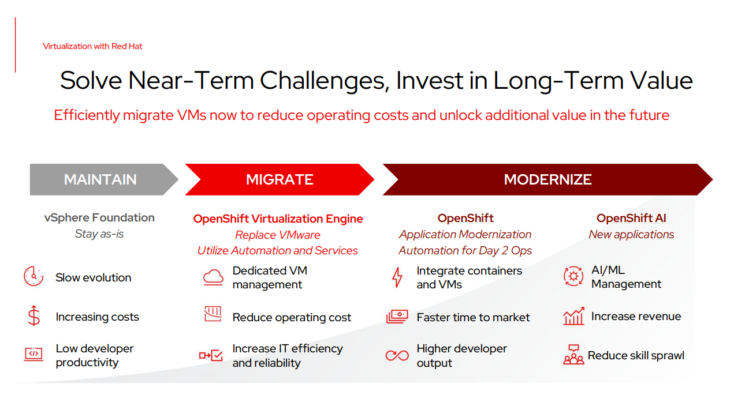
Virtualization Migration - Technical Discovery & Risk Assessment

Slide 8
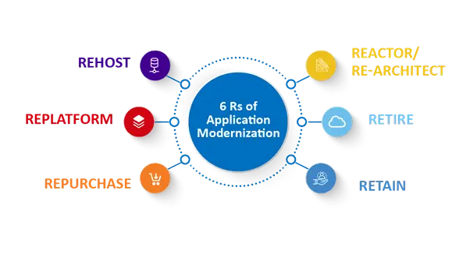
Phase 1: Assess & Categorize
Inventory legacy applications
Apply 6R strategy (Rehost, Retire, Retain, etc.)
Identify containerization candidates
Phase 1: Assess & Categorize
Inventory legacy applications
Apply 6R strategy (Rehost, Retire, Retain, etc.)
Identify containerization candidates
Quick Wins:
~30% applications ready for containerization
Unified platform for VMs + Containers
Modern CI/CD pipelines
Virtualization Migration - Technical Discovery & Risk Assessment

Slide 9
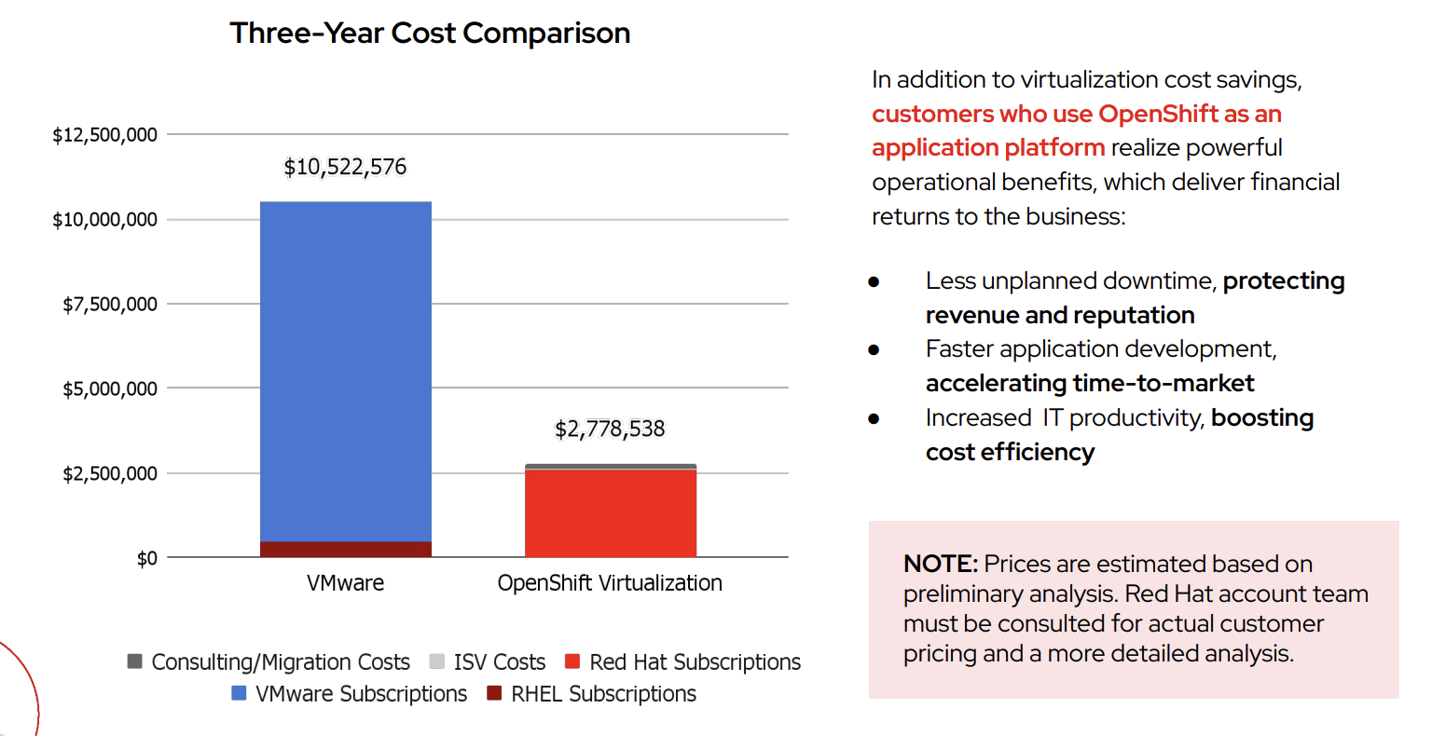
Virtualization Migration - Technical Discovery & Risk Assessment

Slide 10
Executive Summary
Red Hat has successfully completed the assessment of Healthcare Provider Company’s VMware environment and has built a proposal to migrate approximately 80’000 of HPC’s 80k VMs running on VMware using a scaled migration factory over a period of three years. This deck highlights the key findings, recommendations, and migration approach.
Phase | Deliverables / Outcomes | Duration | Estimated Pricing
Foundation | OpenShift Virtualization and Migration Factory Build and Operationalization | 6 Months | $632,000*
Accelerated Migration | Successful Migration of the existing 80k VMware Virtual Machines | 60 Months | $3,000,000*
Containerization and Testing Squads | Teams focused on containerizing, testing and skills transfer to product teams *Best effort, replatform viable applications | 12 Months
Red Hat Subscriptions after migration | Subscription growth for: OpenShift Platform Plus | 3 year projection | $1,200,000*
Virtualization Migration - Technical Discovery & Risk Assessment

Slide 11
Next Steps: Production and Migration Factory
OpenShift Virtualization Migration Factory
Deploy production infrastructure and migrate at scale
Objectives:
Prepare infrastructure, evaluate workloads, test migration
Achieve production readiness
Build automated platform provisioning process
Build Migration Factory and complete first migration wave
Approach:
Red Hat builds production platform and processes for automated, repeatable, and scalable provisioning
Red Hat deploys and configures OpenShift Virtualization in preparation for Migration Factory
A Red Hat delivery team directs multiple squads to support VM owners through the migration
Red Hat deploys Advanced Cluster Management (ACM) for cluster fleet management
Virtualization Migration - Technical Discovery & Risk Assessment

